Slide 1
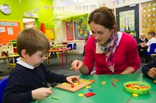
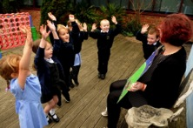
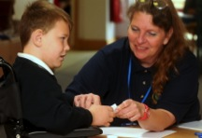
Supporting Governance Governors Sessions 2016/17 April 2016 Gary Peile

Slide 2
Agenda
Welcome to all and a warm welcome to new governors
ALT update, including finance, admissions and future size of the Trust
Key Session – How to effectively hold the school to account

Slide 3
Finance - 2016/17 Budget Update
Planning template issued to all schools
Iterations of budget – include SLT /Governors / ALT Finance Manager
Identify significant procurement priorities
3 Year forecasts – Y1 detail
Budget to Central Finance by 31st May

Slide 4
Finance - 2016/17 Budget Update
Board have asked for report where reserves are below 5% or above 8%
We recognise the significant pressure on all school budgets and are supporting schools with their 3 year plans

Slide 5
Admission Arrangements within ALT

Slide 6
Background
ALT is the legal Admitting Authority for all pupils that join schools within The Trust
Current admission criteria is inconsistent across the Trust due to arrangements within two local authorities
Admission appeals are currently administered by local authorities

Slide 7
The New Arrangements
For pupils that are admitted in September 2017, each school will have a revised set of admission procedures, that is consistent across the Trust
These have been forwarded to schools & governing bodies
From September 2016 ALT will administer any appeals from parents whose children have been refused places

Slide 8
Appeals Panels
Independent panel members are required to hear and decide upon appeals
Training will be given by independent providers
Independent, trained Clerks will be provided
Training is booked for 9th May
We would welcome colleagues from the Trust to hear appeals in areas other than their own

Slide 9
The Future Size of the Trust

Slide 10
How will a small increase in size help?
Brings new knowledge, skills and experience to the Trust, adding school improvement capacity
Expands potential for Value for Money – e.g. procurement
Enables the Trust to maintain a team to support schools, whilst not increasing the central percentage

Slide 11
Our business plan envisages around 7-8 schools in each hub and we await news on approval for:
Albert Pye Primary and Ravensmere Infant Schools from Beccles to join us
DFE sign off on Cambridgeshire’s request that ALT to sponsor new secondary and special schools on a single campus at Littleport
New primary schools to serve Chatteris and Ipswich

Slide 12
The Future Size of the Trust – what next?
We have laid down a marker to establish a new primary school for Lowestoft in 2018
Potential for one special school to join us to help deliver the new provision for Littleport.
If all agreed, we would be at 22 schools in 2018, although numbers differ in each hub.

Slide 13
Website
News
Essential documents
Resources for governors and links
Social media integration
Background information

Slide 14
Working with ALT

Slide 15
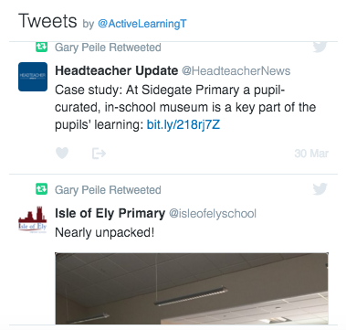
News

Slide 16
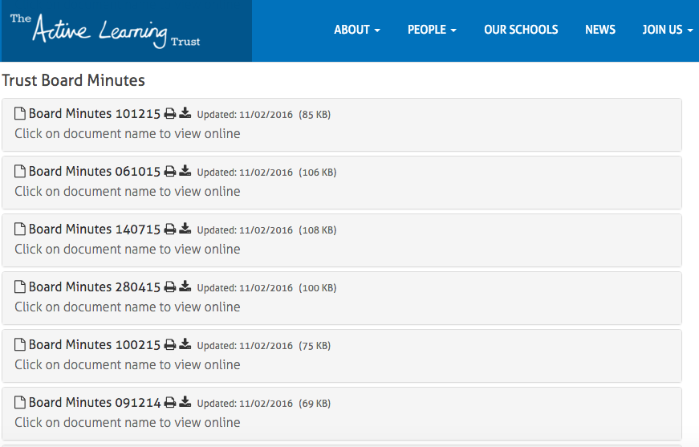
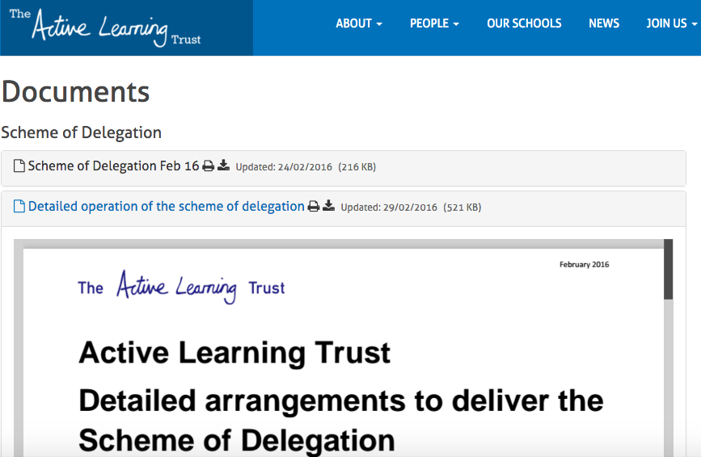
Documents

Slide 17
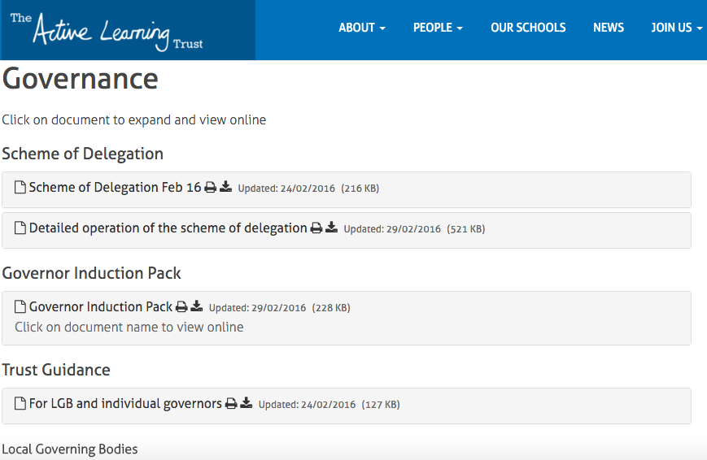
Governance

Slide 18
Key session – how to effectively hold the headteacher to account
Marilyn Toft, Trevor Folley

Slide 19
Intended outcomes
Increased knowledge and understanding of the range and type of questions that can be used to:
hold the Headteacher to account
support the strategic thinking of the Headteacher
Improved governor confidence and skills in undertaking these responsibilities
Application of the governors’ toolkit as a vehicle for supporting this process

Slide 20
Introduction
The role of governors – asset to school and added value
Scaling wheel (September 2015)
Apply knowledge and understandings to practice
You can do it!

Slide 21
Opening activity
Choose one of the extracts from recent Heads’ reports.
Identify three questions that might be asked to hold the headteacher to account and develop strategic thinking …
(mixed groups)

Slide 22
The governor toolkit
Familiarisation with the toolkit
Introduction to a model for generating purposeful questions

Slide 23
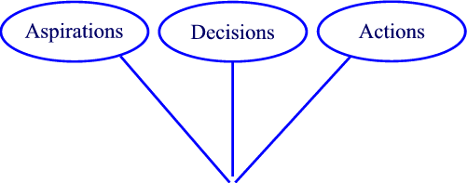
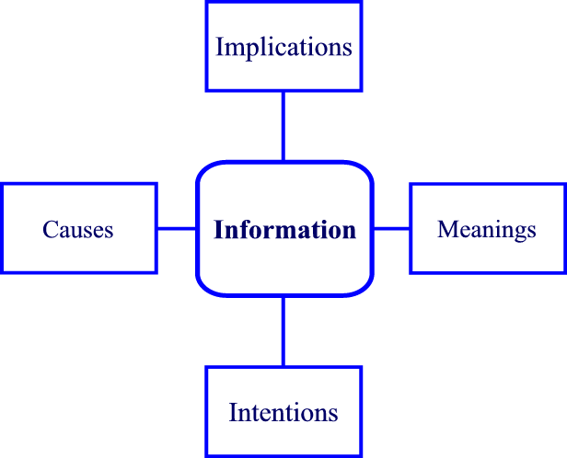
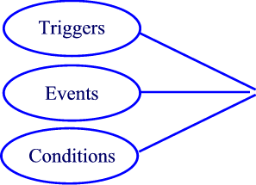
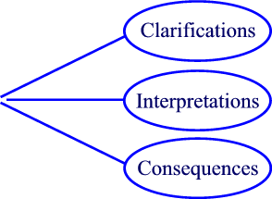
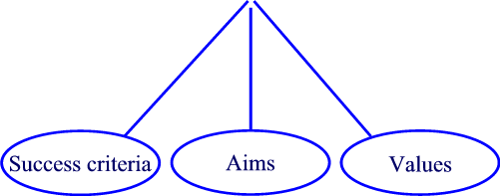
Supportive scrutiny
Notes:
Questions are the spotlight – coming from multiple angles, they highlight the detail needed to improve a school.
They are the ‘collective intelligence’ of the governing body.
It is okay to spend time on clarification – or can’t engage with topic

Slide 24
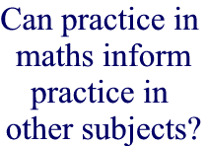
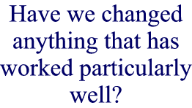
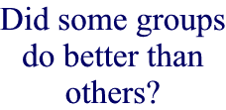

Slide 25
‘Go to’ follow-up questions
What else?
What if?
So what?
How do you know?

Slide 26
‘Go to’ follow-up questions
How is girls’
behaviour?
Has this been matched by better progress?
Boys’ behaviour has improved since December
What else?
What else has improved?

Slide 27
‘Go to’ follow-up questions
What if we held events after
6 pm?
What if the dip has something to do with the events rather than parental engagement?
Parents are less engaged this year. Attendance at school events has dipped.
What if?
What if their attendance dips further? What will be the impact?

Slide 28
‘Go to’ follow-up questions
Who will benefit?
What will they be focusing on?
We have employed three additional Learning Support Assistants
So What?
How will this address our priorities?

Slide 29
‘Go to’ follow-up questions
How do you know the curriculum changes will lead to better outcomes?
How do you evaluate the quality of teaching?
Improved teaching and curriculum changes will lead to a 5% increase in pupils achieving the expected standard
How do you know?
Where did the figure of 5% come from?

Slide 30
Enriching the challenge
Reflect on your initial set of questions – how might these be:
Enhanced
Added to
Developed further
Follow-up questions

Slide 31
Closing activity
Feedback
Next steps
Evaluation

